Slide 1
Stability Of Machine Learning Predictive Features Under Limited Data
PRESENTED BY
IBRAHIM SHA .K (815422243007) PRASANNA .G (815422243013)
RAHUL. P (815422243016)
VIJAYANANDH .G (815422243028)
Guided By:
Mrs.Reeta Joldrine Ph.D..,
AP/CSE
Sri Ramakrishna College of Engineering Perambalur .

Slide 2
Aim and Objective
Aim
The aim of this project is to analyze and evaluate the stability of machine learning predictive features under limited and incomplete data conditions, and to compare traditional machine learning methods with a descriptive ML approach that utilizes data abstraction techniques to ensure consistent, explainable, and accurate feature selection for reliable automatic decision-making.
Objectives
Evaluate the stability of predictive features in machine learning models when trained on limited and incomplete data.
Compare traditional machine learning methods with a descriptive ML approach based on data abstractions.
Assess classification accuracy under increasing data incompleteness.
Analyze feature selection consistency to improve explainability and reliability of ML decisions.
Demonstrate the potential of abstraction-based ML for robust automatic decision-making in real-world, data-scarce scenarios.

Slide 3
Abstract
In a world where Machine Learning (ML) is increasingly used to make predictions about critical events, such as health outcomes, it is crucial to ensure decision-makers have access to explainable, consistent, and relevant predictive features.
ML prediction relies on perfect data with similar distributions for testing and validation. These results are compared with those of humans, who use more noisy and limited data.
Human predictions overcome those limitations by learning from abstractions.
It demonstrates the possibility of developing ML capable of automatic decision-making.

Slide 4
SCOPE
Focuses on machine learning classification models operating under limited and incomplete data conditions.
Examines predictive feature stability and explainability rather than only accuracy.
Compares traditional ML techniques with an abstraction-based descriptive ML approach.
Evaluates performance using classification accuracy and feature selection consistency.
Applicable to critical decision-making domains such as healthcare and risk prediction, where data scarcity is common.

Slide 5
Literature Survey
S. No. | Title of the Paper | Author & Year | Methodology | Advantages | Disadvantages
1 | Deep learning for low-data drug discovery: Hurdles and opportunities | D. van Tilborg, H. Brinkmann, E. Criscuolo, L. Rossen, R. Özçelik, and F. Grisoni, 2024 | Transfer Learning for Drug Discovery | Efficient Knowledge Extraction from Small Datasets Faster Iteration in Early-Stage Drug Discovery Integration of Prior Chemical and Biological Knowledge | Data Scarcity and Overfitting Limited Model Generalization High Sensitivity to Noise and Bias
2 | CACTUS: A comprehensive abstraction and classification tool for uncovering structures | L. Gherardini, V. R. Varma, K. Capała, R. Woods, and J. Sousa, 2024 | Attribute-Based Explainable Classification (CACTUS) | Strong Explainability and Transparency Effective Handling of Small and Categorical Datasets Efficient and Secure Analytics | Limited Suitability for Very Large-Scale Deep Learning Tasks Reduced Flexibility for Unstructured Data Potential Accuracy Ceiling Compared to Complex Models
3 | Learning from data with structured missingness | R. Mitra et al., 2023 | Missingness-Aware Representation Learning | Encodes Informative Data-Collection Processes Enables Discovery of Hidden Structure Improves Domain-Aware Modeling | Bias and Spurious Correlations Breakdown of Standard Missing-Data Assumptions Reduced Scalability and Generalization

Slide 6
S. No. | Title of the Paper | Author & Year | Methodology | Advantages | Disadvantages
4 | Explainable AI lacks regulative reasons: Why AI and human decision-making are not equally opaque | U. Peters 2023 | Human-in-the-Loop Decision Oversight | Clarifies Limits of Current Explainable AI Strengthens Human–AI Comparison Frameworks Encourages More Responsible XAI Design | Absence of Self-Regulative Reason-Giving Risk of False Transparency Overreliance on Superficial Explanations
5 | SaNDA: A small and incomplete dataset analyser | A. Ibias, V. R. Varma, K. Capała, L. Gherardini, and J. Sousa, 2023 | Explainability-First Ensemble Analysis (SaNDA) | Robust to Small and Incomplete Datasets Built-in Explainability for Clinical Use Enhanced Privacy Preservation | Limited Performance on Large, Well-Curated Datasets Lower Computational Efficiency Domain-Specific Applicability
6 | On evaluation metrics for medical applications of artificial intelligence | S. Hicks, I. Strümke, and V. E. A. Thambawita, 2022 | Multi-Metric Evaluation for Medical AI | Provides Comprehensive Performance Evaluation Facilitates Clinician Understanding of ML Models Supports Standardized Reporting via Web-Based Tool | Complexity of Metrics for Non-Technical Users Difficult Cross-Study Comparisons No Single Metric Fully Captures Model Performance

Slide 7
S. No. | Title of the Paper | Author & Year | Methodology | Advantages | Disadvantages
7 | Why do tree-based models still outperform deep learning on typical tabular data | L. Grinsztajn, E. Oyallon, and G. Varoquaux, 2022 | Tree-Based Ensemble Models (XGBoost / Random Forests) | Tree-Based Models Excel in Medium-Sized Tabular Data Faster Training and Hyperparameter Optimization Robust Interpretability via Feature Importance | Deep Learning Struggles on Tabular Data Sensitivity to Uninformative Features Difficulty Learning Irregular Functions
8 | Machine learning models outperform deep learning models, provide interpretation and facilitate feature selection for soybean trait prediction | M. Gill, R. Anderson, and H. E. A. Hu, 2022, | XGBoost for Trait Prediction | Higher Prediction Accuracy than Deep Learning in Small-to-Medium Data Facilitates Feature Selection and Dimensionality Reduction Provides Interpretability and Biological Insight | Limited Scalability for Extremely Large Genomic Datasets Less Powerful for Unstructured Data (e.g., Images) May Require Careful Feature Engineering
9 | Principles and practice of explainable machine learning | V. Bella and I. Papantonis, ,2021 | SHAP (SHapley Additive exPlanations) | Enhances Trust and Accountability in AI Systems Provides Structured Guidance for Practitioners Supports Both Model-Specific and Model-Agnostic Explainability | Complexity of Modern ML Models Limits Interpretability Risk of Misuse or Misunderstanding of Explainability Tools Data-Specific Biases Can Mislead Explanations

Slide 8
S. No. | Title of the Paper | Author & Year | Methodology | Advantages | Disadvantages
10 | Interpretability and explainability: A machine learning zoo mini-tour | R. Marcinkeviˇcs and J. E. Vogt, 2020 | Post-hoc Explainability Methods | Increased Trust and Transparency Better Model Debugging and Validation Regulatory and Ethical Compliance | Lack of Unified Definitions Trade-off Between Accuracy and Interpretability Risk of Misleading Explanations

Slide 9
EXISTING SYSTEM
The existing system relies on traditional machine learning models trained on large, well-distributed, and complete datasets.
These models assume consistency between training and testing data to achieve reliable predictions.
Feature selection in such systems is often driven by statistical importance rather than stability.
Explainability is limited, especially when data becomes noisy or incomplete.
Performance degrades significantly as data availability decreases.
As a result, traditional ML systems struggle to maintain reliability in real-world, data-scarce scenarios.

Slide 10
DISADVANTAGES
Low Feature Stability
Poor Performance with Limited Data
Lack of Explainability

Slide 11
PROPOSED SYSTEM
The proposed system introduces a descriptive machine learning approach that utilizes data abstractions to identify predictive feature significance.
Unlike traditional models, it is designed to function effectively with limited and incomplete data.
The system emphasizes stable and consistent feature selection across varying data conditions.
It mimics human-like abstraction learning to improve prediction reliability.
Classification performance is maintained even as data quality degrades.
This approach supports explainable and automated decision-making in critical applications.

Slide 12
ADVANTAGES
Improved Feature Stability
Higher Accuracy with Limited Data
Enhanced Explainability

Slide 13
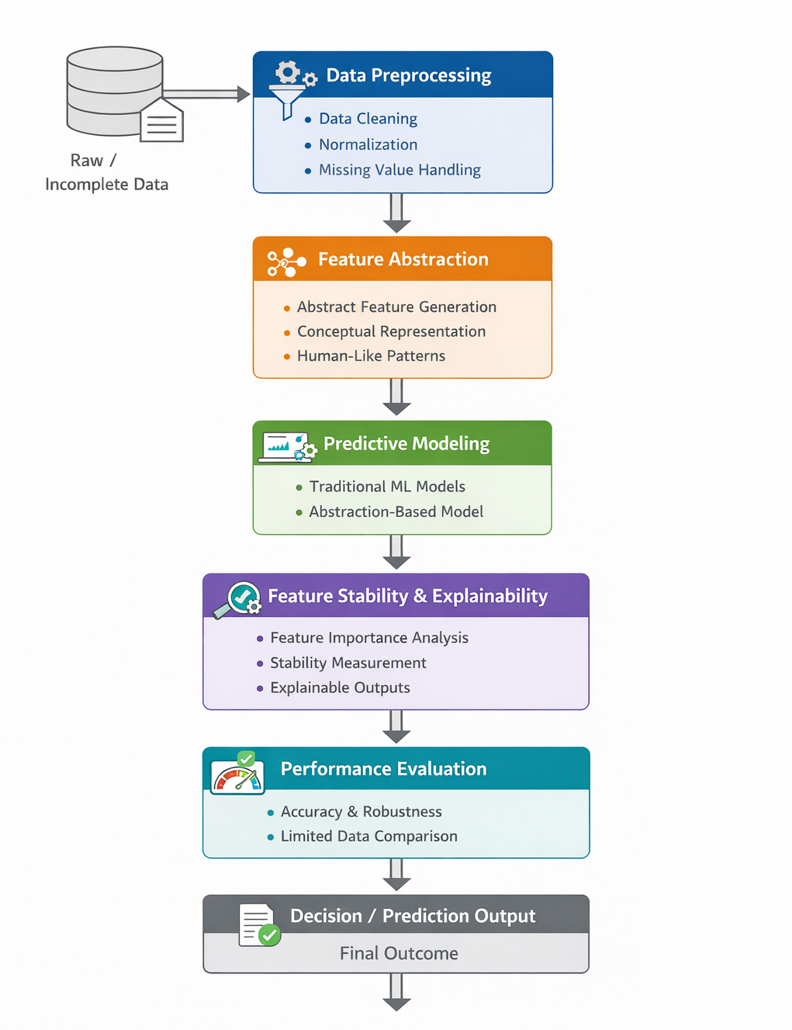
ARCHITECTURE DIAGRAM

Slide 14
MODULES
Data Preprocessing and Incompleteness Modeling
Feature Abstraction and Representation Learning
Predictive Modeling and Classification
Feature Stability and Explainability Analysis
Performance Evaluation under Limited Data

Slide 15
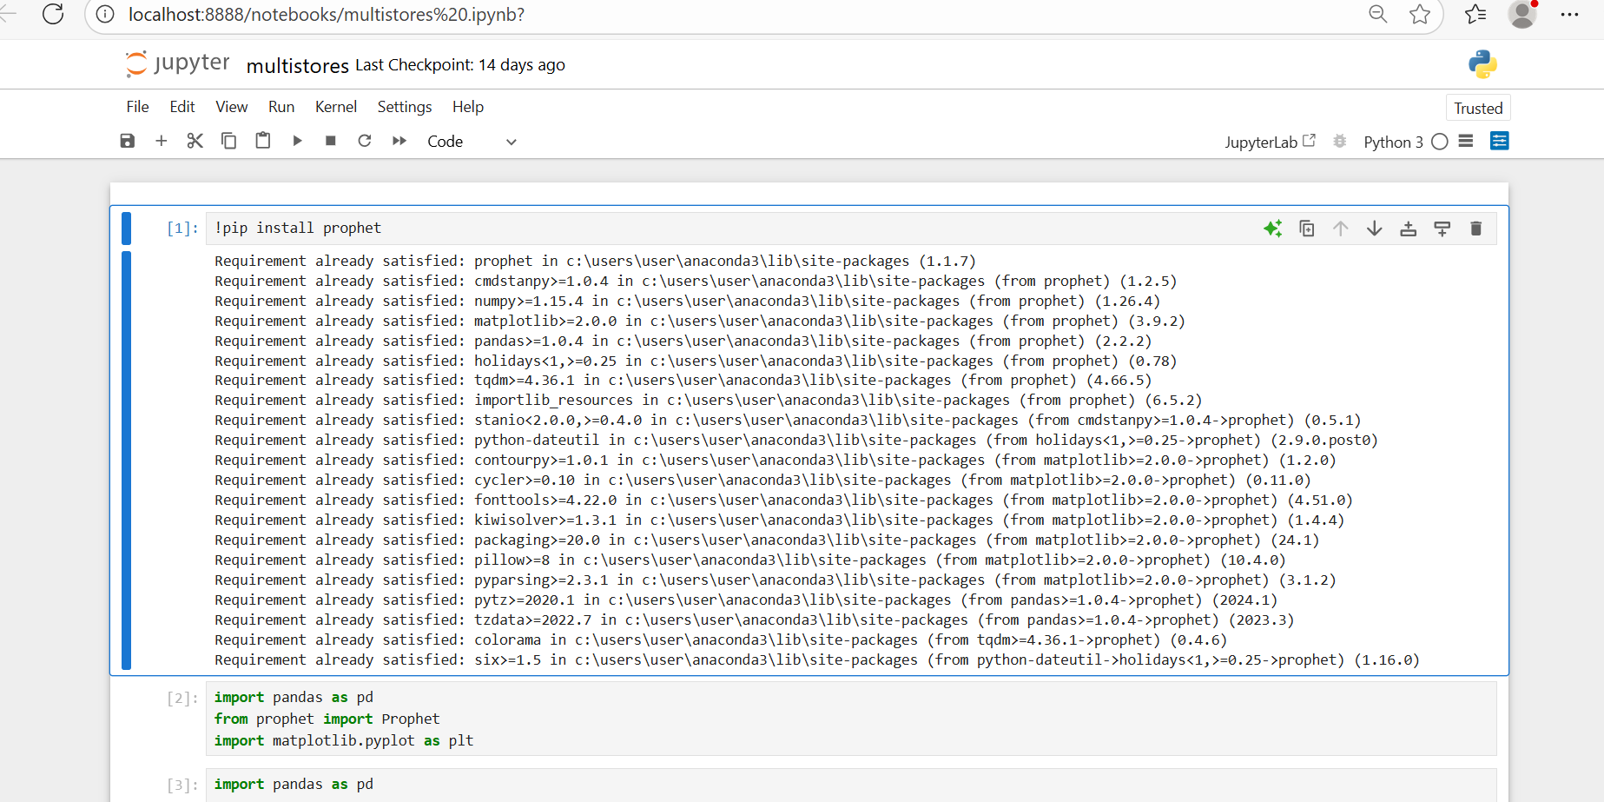
MODULES DESCRIPTION
Data Preprocessing and Incompleteness Modeling
This module is responsible for preparing the dataset for analysis. It handles data cleaning, normalization, and encoding of features.
Additionally, it simulates limited and incomplete data scenarios by introducing controlled amounts of missing values or reduced sample sizes.
This allows the system to evaluate how different machine learning approaches behave as data availability decreases.

Slide 16
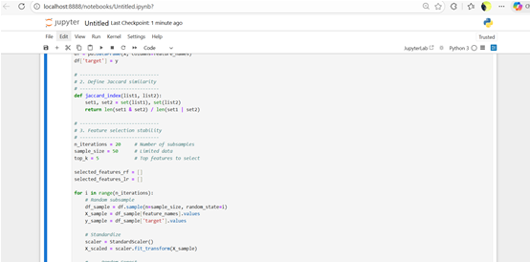
Feature Abstraction and Representation Learning
This module transforms raw input features into higher-level abstractions that capture meaningful patterns in the data.
Instead of relying solely on individual feature values, it learns conceptual representations that are more robust to noise and missing information.
These abstractions aim to mimic human-like reasoning and form the basis for stable and explainable feature learning under limited data conditions.

Slide 17
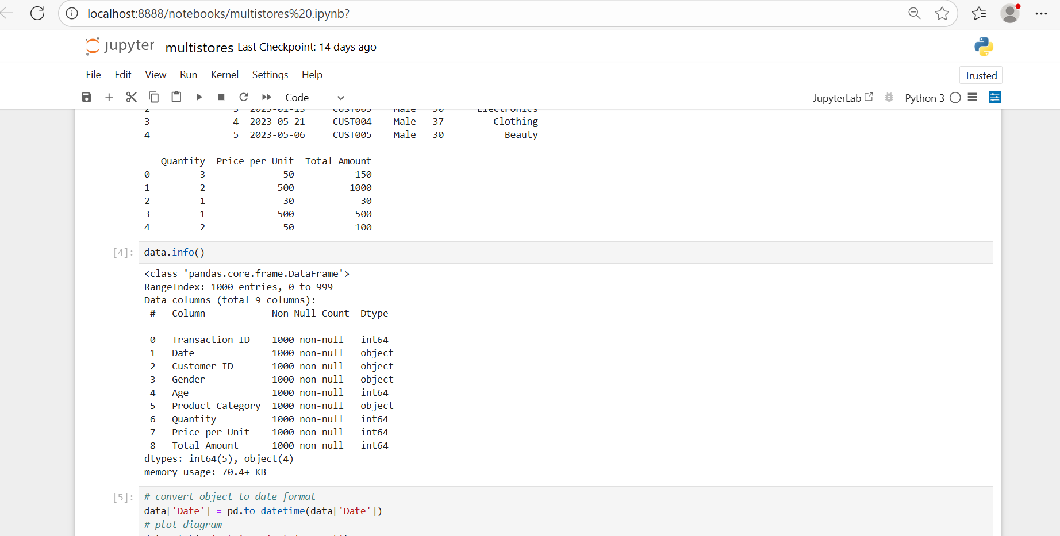
Predictive Modeling and Classification
This module implements and trains machine learning models using both traditional feature-based methods and the abstraction-based approach.
It performs classification tasks and generates predictions based on the learned representations.
The module supports model comparison to analyze how different learning strategies perform when trained on incomplete or reduced datasets.

Slide 18
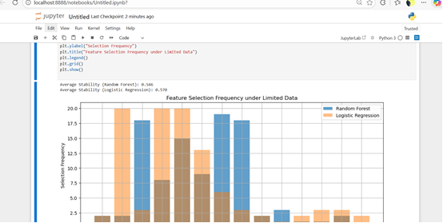
Feature Stability and Explainability Analysis
This module evaluates the consistency and reliability of selected predictive features across multiple training runs and data variations.
It measures feature stability using statistical or similarity-based metrics and provides interpretable explanations of model decisions. The goal is to ensure that important features remain consistent and meaningful, increasing trust in the model’s predictions.

Slide 19
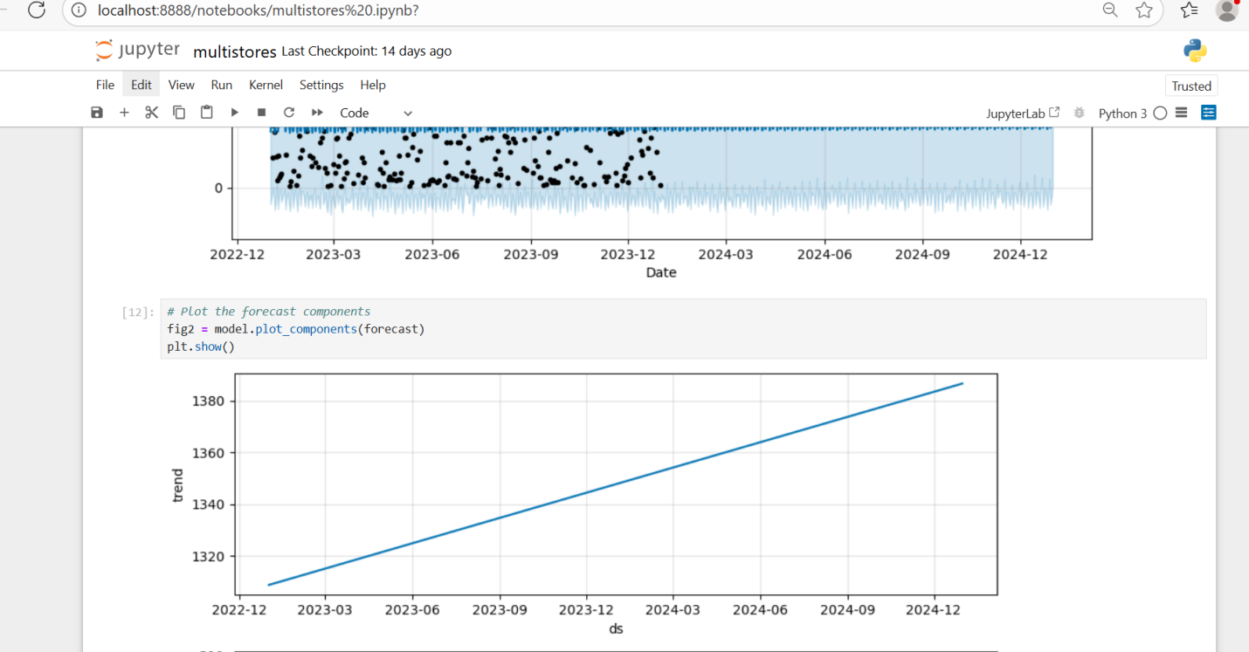
Performance Evaluation under Limited Data
This module assesses overall system performance using metrics such as accuracy, precision, recall, and robustness under varying levels of data incompleteness.
It compares traditional machine learning methods with the abstraction-based approach to demonstrate performance degradation or resilience.
The results help validate the effectiveness of the proposed method in limited-data scenarios.

Slide 20
Codings
# =============================
# STABILITY OF ML PREDICTIVE FEATURES UNDER LIMITED DATA
# =============================
import numpy as np
import pandas as pd
import matplotlib.pyplot as plt
from sklearn.datasets import make_classification
from sklearn.ensemble import RandomForestClassifier
from sklearn.linear_model import LogisticRegression
from sklearn.preprocessing import StandardScaler
from itertools import combinations
from collections import Counter
# -----------------------------
# 1. Generate synthetic dataset
# -----------------------------
X, y = make_classification(
n_samples=500, n_features=15, n_informative=5,
n_redundant=2, n_repeated=0, n_classes=2, random_state=42
)
feature_names = [f"F{i}" for i in range(X.shape[1])]
df = pd.DataFrame(X, columns=feature_names)
df['target'] = y

Slide 21
# 2. Define Jaccard similarity
# -----------------------------
def jaccard_index(list1, list2):
set1, set2 = set(list1), set(list2)
return len(set1 & set2) / len(set1 | set2)
# -----------------------------
# 3. Feature selection stability
# -----------------------------
n_iterations = 20 # Number of subsamples
sample_size = 50 # Limited data
top_k = 5 # Top features to select
selected_features_rf = []
selected_features_lr = []
for i in range(n_iterations):
# Random subsample
df_sample = df.sample(n=sample_size, random_state=i)
X_sample = df_sample[feature_names].values
y_sample = df_sample['target'].values
# Standardize
scaler = StandardScaler()
X_scaled = scaler.fit_transform(X_sample)

Slide 22
# --- Random Forest ---
rf = RandomForestClassifier(n_estimators=100, random_state=i)
rf.fit(X_scaled, y_sample)
importances = rf.feature_importances_
top_features_rf = np.argsort(importances)[-top_k:]
selected_features_rf.append([feature_names[j] for j in top_features_rf])
# --- Logistic Regression ---
lr = LogisticRegression(max_iter=1000, random_state=i)
lr.fit(X_scaled, y_sample)
coefs = np.abs(lr.coef_[0])
top_features_lr = np.argsort(coefs)[-top_k:]
selected_features_lr.append([feature_names[j] for j in top_features_lr])
# -----------------------------
# 4. Compute Jaccard stability
# -----------------------------
stability_rf = [jaccard_index(f1, f2) for f1, f2 in combinations(selected_features_rf, 2)]
stability_lr = [jaccard_index(f1, f2) for f1, f2 in combinations(selected_features_lr, 2)]
print(f"Average Stability (Random Forest): {np.mean(stability_rf):.3f}")
print(f"Average Stability (Logistic Regression): {np.mean(stability_lr):.3f}")

Slide 23
# -----------------------------
# 5. Feature selection frequency plot
# -----------------------------
all_selected_rf = [f for sublist in selected_features_rf for f in sublist]
all_selected_lr = [f for sublist in selected_features_lr for f in sublist]
freq_rf = Counter(all_selected_rf)
freq_lr = Counter(all_selected_lr)
plt.figure(figsize=(12,5))
plt.bar(np.arange(len(freq_rf)), list(freq_rf.values()), tick_label=list(freq_rf.keys()), alpha=0.7, label="Random Forest")
plt.bar(np.arange(len(freq_lr)), list(freq_lr.values()), tick_label=list(freq_lr.keys()), alpha=0.5, label="Logistic Regression")
plt.xlabel("Features")
plt.ylabel("Selection Frequency")
plt.title("Feature Selection Frequency under Limited Data")
plt.legend()
plt.grid()
plt.show()

Slide 24
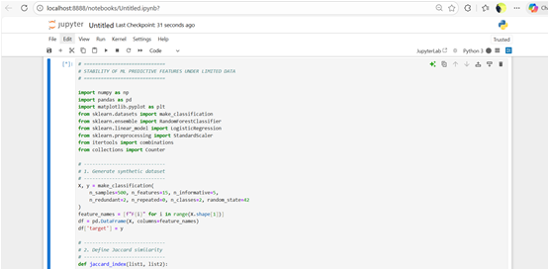
SCREENSHOT
Import Libraries

Slide 25
Dataset Analysis

Slide 26
Performance Evaluation under Limited Data

Slide 27
Feature selection

Slide 28
REFERENCES
Breiman, L. (2001). Statistical modeling: The two cultures. Statistical Science, 16(3), 199–231.
Ribeiro, M. T., Singh, S., & Guestrin, C. (2016). “Why should I trust you?” Explaining the predictions of any classifier. Proceedings of the 22nd ACM SIGKDD International Conference on Knowledge Discovery and Data Mining.
Guyon, I., & Elisseeff, A. (2003). An introduction to variable and feature selection. Journal of Machine Learning Research, 3, 1157–1182.
Domingos, P. (2012). A few useful things to know about machine learning. Communications of the ACM, 55(10), 78–87.

